Slide 1
Helix™ eProcurement Integration

Slide 2

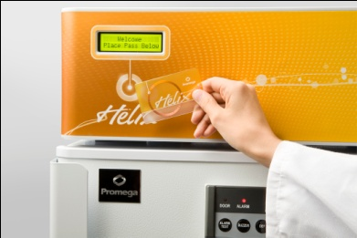


Helix™ eProcurement Integration
Why integrate ?
Integration Advantage
  Visibility and reporting capacity for Helix™ spend
  Unique purchase orders for Helix™ transactions
  Compatibility and compliance with workflow approval processes
  Helix™ purchase data availability for review/approval and tracking
  Electronic invoicing

Slide 3
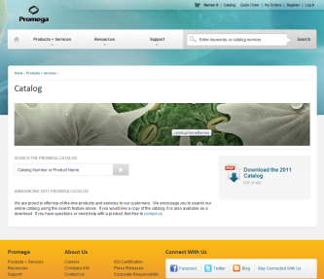



Current Process: Manual Entry Required
  Researcher signs up for Helix™Card at promega.com/helix
  Researcher makes Helix™ System purchase
  Pending sales order created under Helix customer profile
  Initial order confirmation sent to customer
  Invoice issued
  Once approved, requisition is manually entered in
  customer system
  Requisition is processed through customer workflow
  PO assigned to requisition / purchase
  Replenishment Inventory developed based on PO usage data
Purchases manually entered into your procurement system

Slide 4
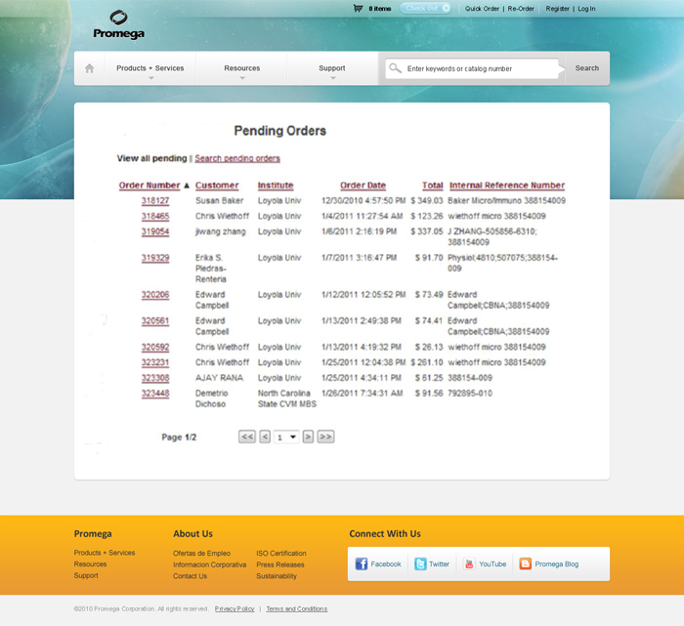
New Helix™/Punch-Out Web Portal Approval
View and Retrieve
transaction data
After product is
removed from the
Helix unit an
administrator or
customer
can punch in to
promega.com to
view and identify
orders for retrieval
into their workflow.

Slide 5


New Helix™/Punch-Out Web Portal Approval
  Researcher signs up for Helix™Card at promega.com/helix
  Researcher makes Helix™ System purchase
  Helix order posted to customer specific Promega/ Helix web portal
  Order contains Helix card holder-specific information
  Notification sent to customer
  Requisition is delivered to customer system
  Requisition is processed through customer workflow
  PO is transmitted to Promega
  Replenishment Inventory developed based on PO usage data
NEW! Partner Admin or End User punches out to promega.com to retrieve requisition and forward to eProcurement system
Once initiated by customer, “Punch Out” enables communication between your software and the Helix portal

Slide 6
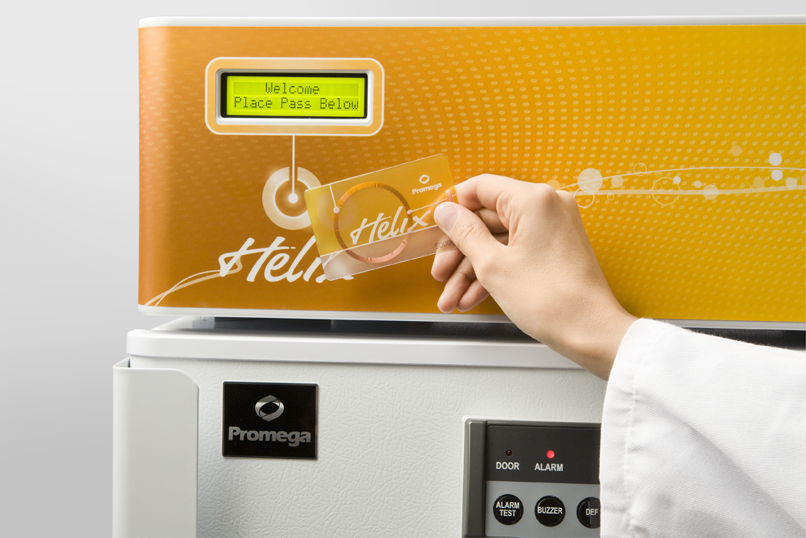
Helix™/Punch-Out Integration Benefits
Punch-out integration makes it easy to track and pay for Helix™ purchases using existing processes!
  You can view Helix™ requisitions using the Promega punch-out system
  You control retrieval of requisitions for processing in your Procurement system
  Purchase Orders for Helix™ products are issued in compliance with institutional requirements
  Purchase Orders are sent to Promega
  for invoicing
  Data is visible and reportable
  You control the requisition data flow
  into your eProcurement system

Slide 7
Helix™/Punch-Out Integration Benefits
Use the punch-out process to review Helix™ purchases and interface with your eProcurement system
  On-site product availability. No shipping costs.
  Helix™ transactions visible to eProcurement systems
  Electronic requisitions, purchase orders, order confirmation and invoicing
  Precise association of requisitions,
  purchase orders and Invoices
  Compatibility and compliance with
  your workflow approval process
  Reduced expense and increased
  efficiency

Slide 8

Next Steps
Let’s get the connection right!
Questions Welcome
Helix is a trademark of Promega Corporation. Please visit www.promega.com/helix for more information.

